Slide 4
Click here

Slide 10
Click here
Click here
Click here
Click here

Slide 12
Click here
Click here
Click here

Slide 14
Click here

Slide 15
Click here
Click here

Slide 16
Click here
Click here

Slide 18
Click here
Click here
Click here
Click here

Slide 22
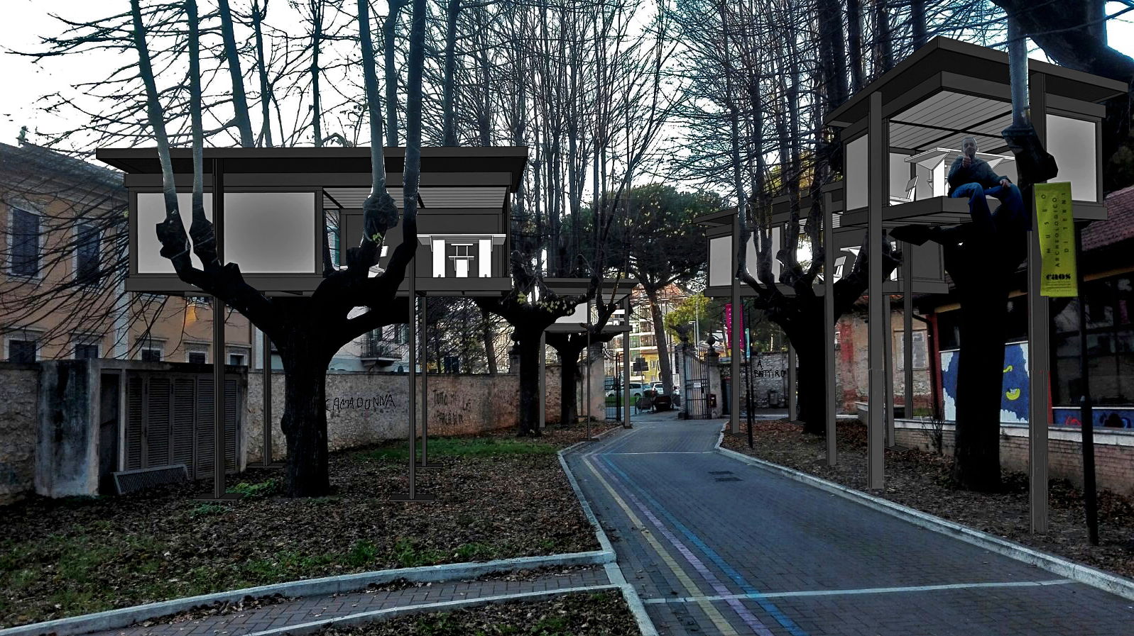
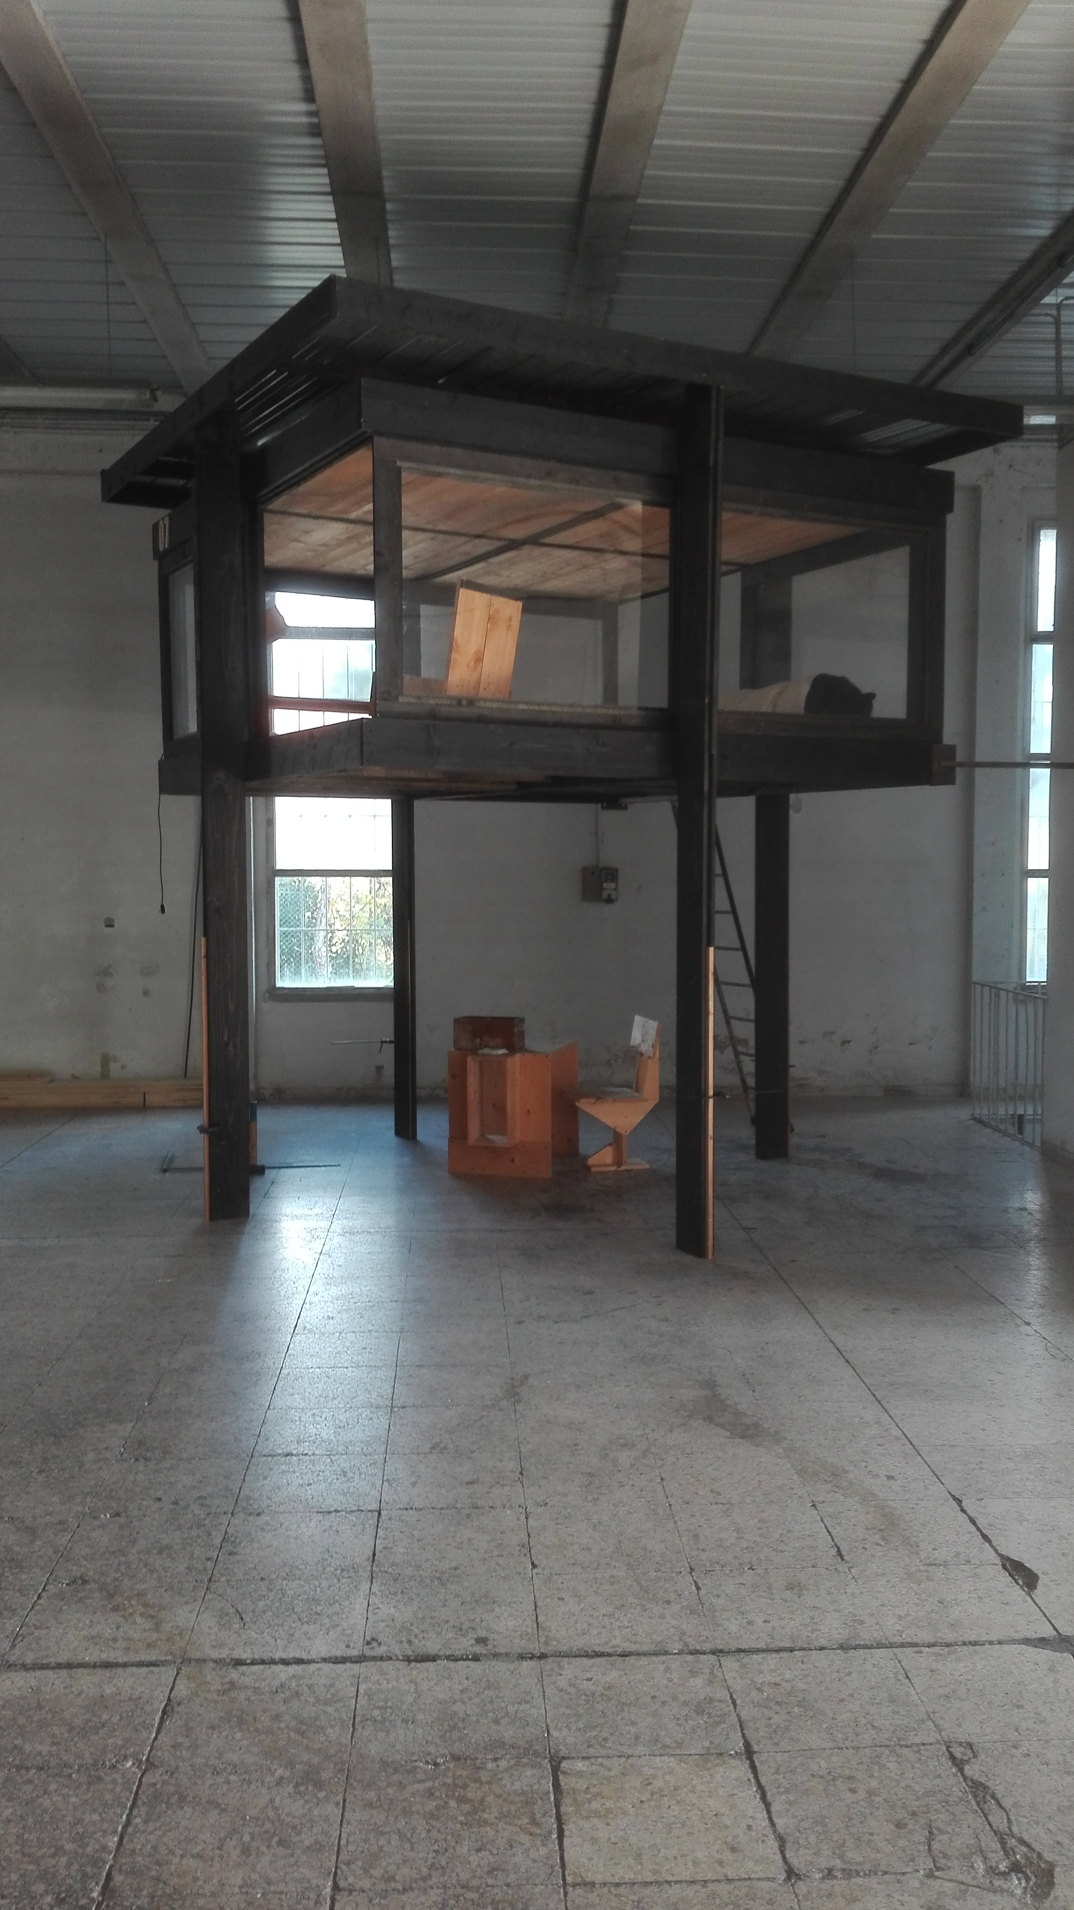
1. Rendering for MAKE FOREST#terni
2. Prototype for a house

Slide 25
4. New prospectives: a Galaxy

